Slide 1
(M)ulti-media (R)eal (T)ime AI
AI-Powered Sports Commentary System By Tristian Sellers

Slide 2
Why Mr. Tai?
Two summers ago, I was deeply invested into starting my own franchise in the game series Madden, with the goal of making the Chicago Bears into something they are not, yet... But as I played more and more, I noticed that although I was immersing myself in the game, the announcers repeating the same voice lines each game or even in the same game limited and took away from that immersion. Thus, I saw the need for innovation.
Problem:
Repetitive Commentary in Sports Gaming
Solution:
AI – Generated, play-by-play narration
Dynamic, role-based commentary
Static game voice lines repeat every match
Mr. Tai generates custom commentary for each clip

Slide 3
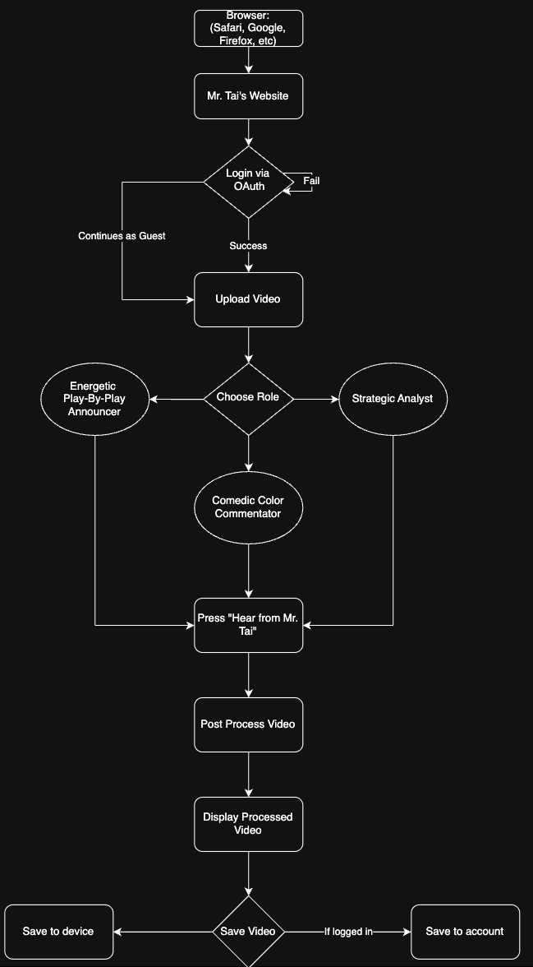
How will Mr. Tai work?

Slide 4
What will Mr. Tai need?
AI: PyTorch, Hugging Face
Backend: FastAPI
Frontend: React
Cloud: Google Cloud
CI/CD: GitHub Actions

Slide 5
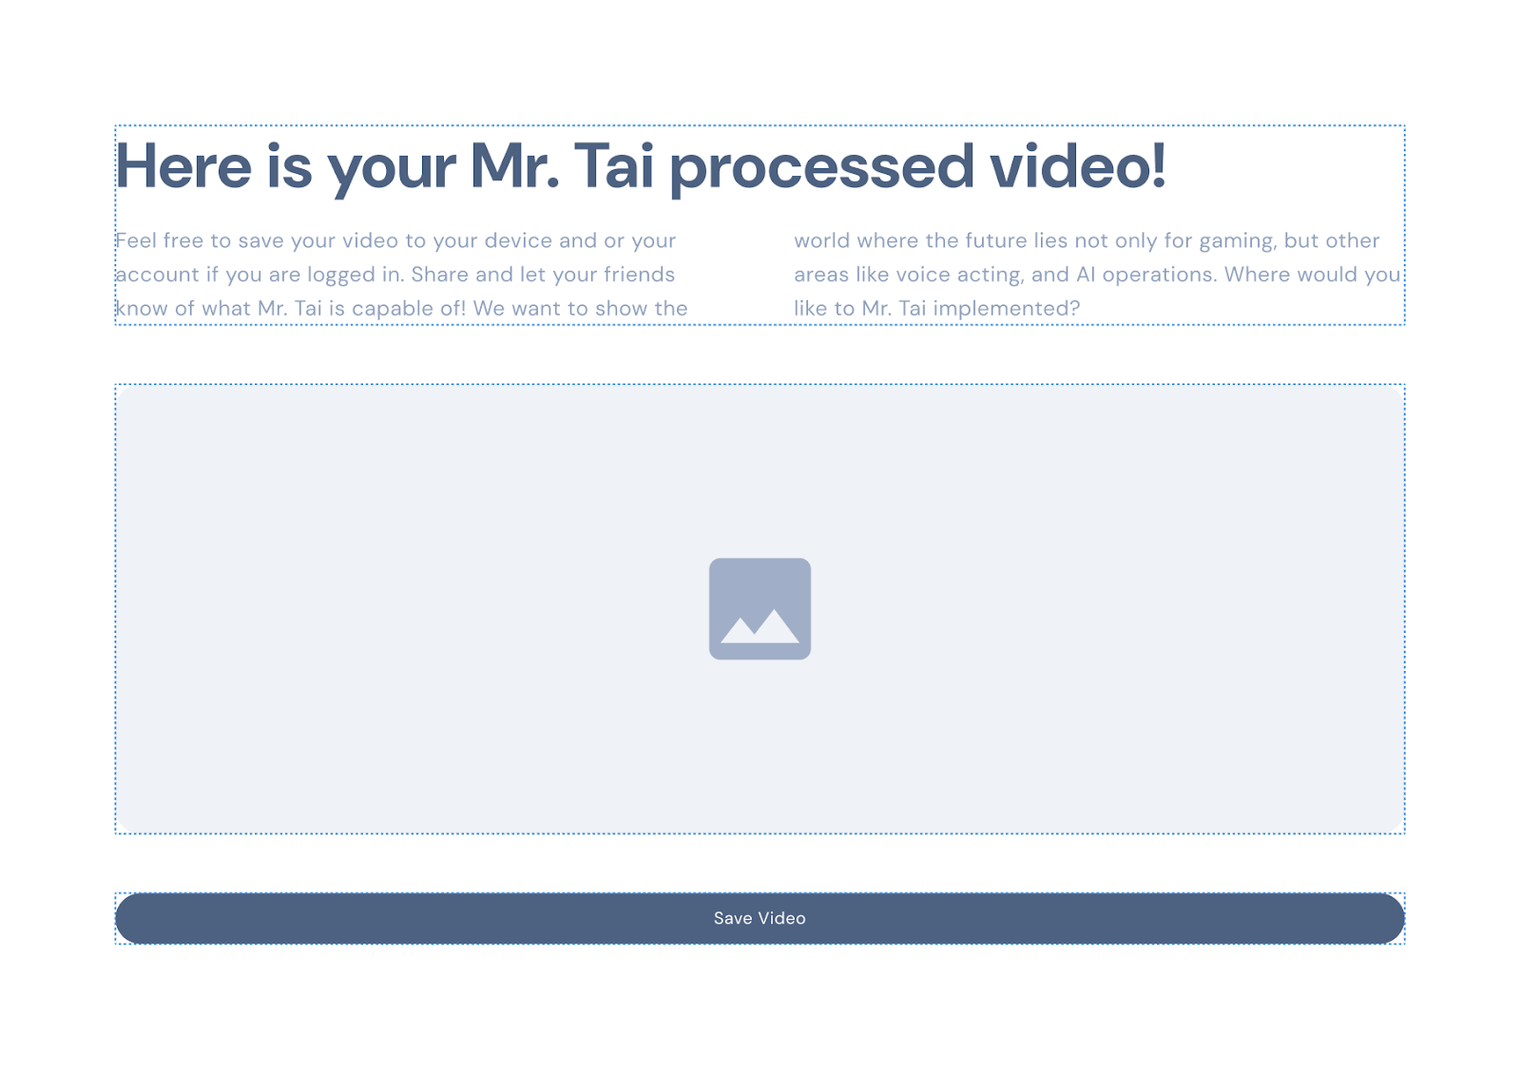
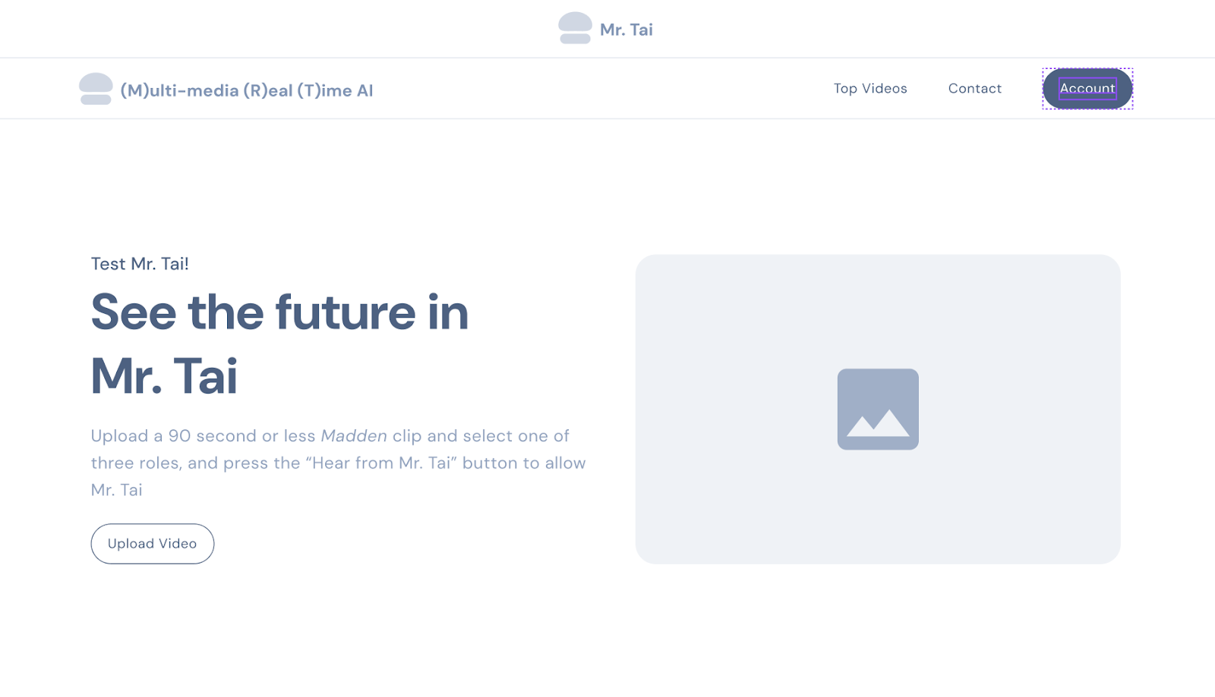
How will Mr. Tai look?

Slide 6
Development Timeline
Month 1: Setup + Research
Month 2: MVP prototype
Month 3: UI + Features
Month 4: Polish + Deploy

Slide 7
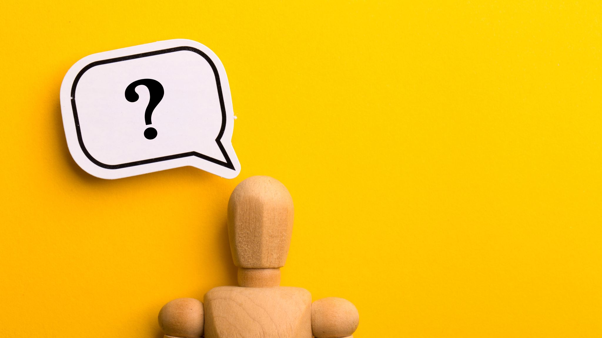
Thank you! Questions?

